Slide 1
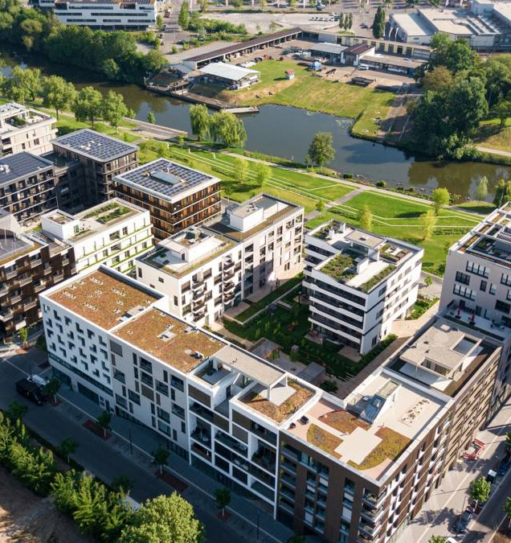

Stairway to Heaven: Saving the world via Point Access Blocks
Dylan Mumm
Notes:
“Welcome! If I told you that we could reduce greenhouse gas emissions while also making our cities more beautiful and convenient, putting more cash in our pockets, and decreasing displacement or gentrification, all without any noticeable sacrifices, would you believe me? I think that all climate change solutions don’t necessarily demand tightening our belts or sacrificing some product, service, or luxury that consumes emissions and replacing it with other with less or no emissions. What I’ll be discussing today is one of those solutions – one that will drastically reduce greenhouse gas emissions. My name is Dylan Mumm, and as you may have guessed – I am talking about revising local staircase regulations.”
42 seconds

Slide 2
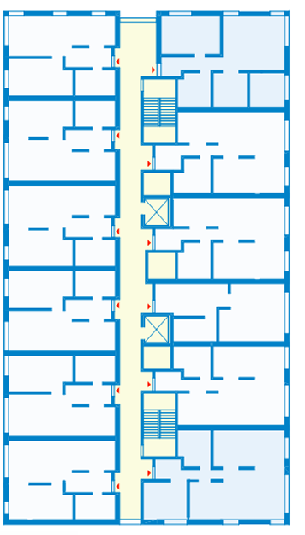
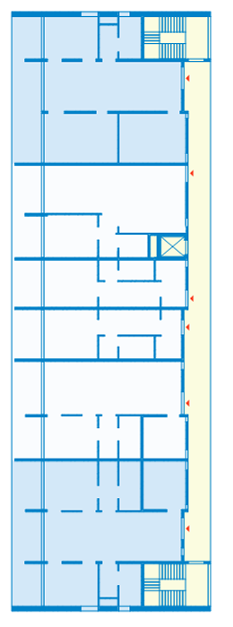
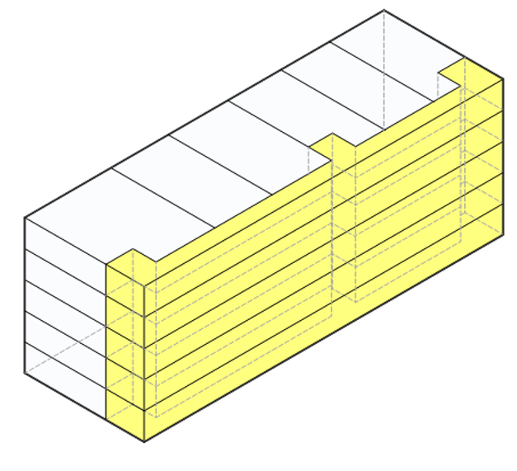
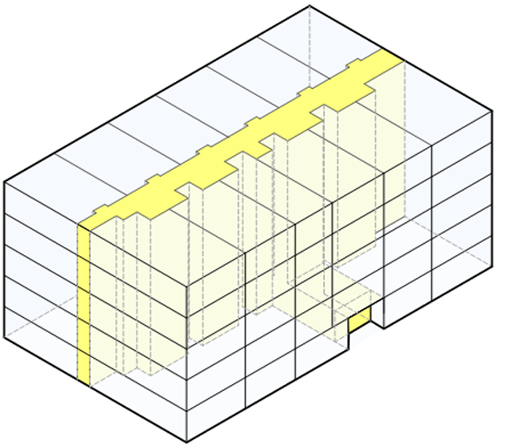
What it is not:
Single loaded corridor
double loaded corridor
Notes:
To explain what a point access block is, it’s important to first understand what it isn’t. Single loaded corridors are similar to cheap motels where stairways access a passageway or corridor. All units are situated on one side, which allows residents to cross ventilate and receive multiple sides of daylight if and only if built with windows facing an exterior corridor – which limits privacy as well as sound isolation. This design is not spatially efficient, resulting in a large percentage of the development dedicated solely to these corridors and staircases. On the other hand, double loaded corridors are much more spatially efficient. Stairways access a corridor in the middle of the building with units accessed on both sides. However, this design generally results in very deep and very large buildings. Most units only receive daylight and ventilation coming from the single exterior wall. Corner units can get some additional ventilation or daylight, but not a significant amount more. Larger and family-sized units are awkward and require a lot of space in order to facilitate what amounts to another hallway to get between the units different rooms. Because of this and the often completely impersonal atmosphere of the structure, developers rarely build units for families.
1m 18s

Slide 3
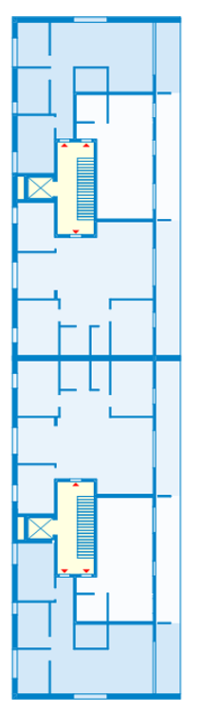
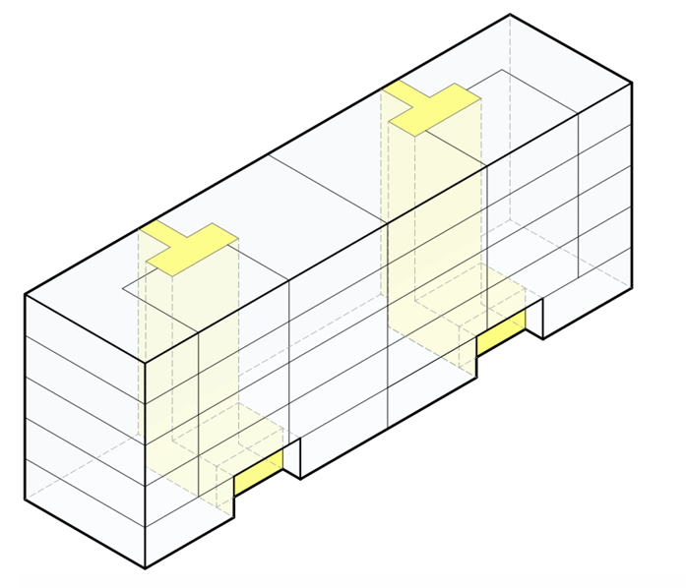
What it is
Modular Single-Stair Block
Single stair building
Dwellings exit to this staircase and a potential elevator’s landing
Can be placed one after the other, separated by air or a firewall (see pictures to right), indefinitely
It is also almost entirely illegal in the United States past 3 stories tall

Slide 4
Brief history:
Pre-modern:
Primary urban housing before automobiles, maximizes density without elevators
Often stretches for miles with little interruption
Fire-resistant material
20th century, proliferation of automobile:
Large exodus from cities, cities no longer demand more housing
American point access blocks largely destroyed for offices, highways, and parking lots
American cities sacrifice density for fire safety
Two staircases to exit connected by corridor on every floor
Fire sprinklers
Pressurized staircases
Fire alarms
Continental European, Asian cities keep stock of point access blocks, see no reason to significantly adjust fire safety codes
Language and culture barrier imposes limits on knowledge and technology sharing between US and Central Europe
Notes:
Pre-modern:
Primary means of housing people in cities before automobiles, cheap and allows for incredible density when any additional walking distance meant substantial time and energy
Would stretch for miles, whether on a commercial street or not. On commercial streets, allows for business owners on the first floor to simply live above their shop
Constructed of solid, naturally fire-resistant material such as brick or stone
20th century, proliferation of automobile:
Large exodus from cities causes automobile sprawl, cities find themselves lacking demand, particularly in US.
American neighborhoods of point access blocks are destroyed for highways and parking lots
American cities, now no longer faced with the necessity to build more, ban single staircase dwellings for new buildings to increase fire safety as modern fire safety technology were not established and developers favored flammable building
European cities largely keep housing stock of point access blocks and see no reason to adjust fire safety codes, particulary with their safer electric systems

Slide 5
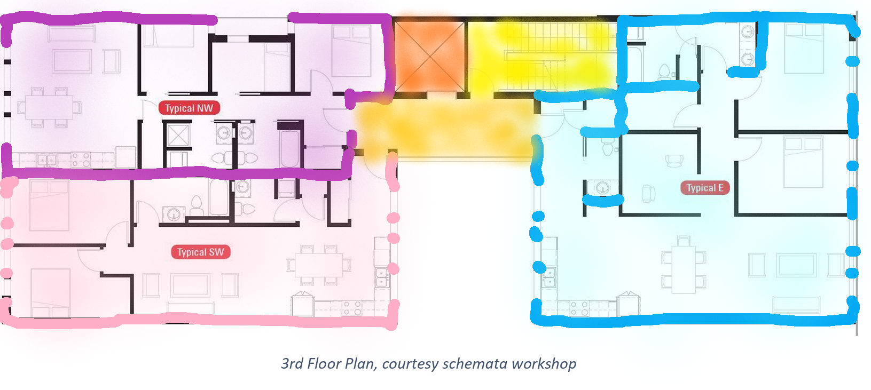
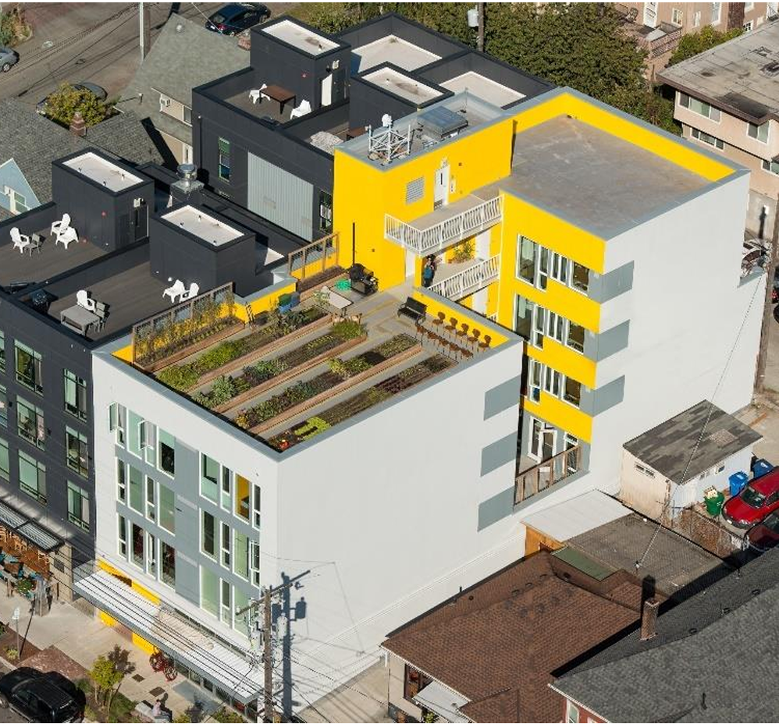
Saving the world?
Direct Environmental Benefits:
Substantial decrease in embodied carbon of construction
Substantial decrease in operation carbon emissions:
Cross ventilation
Compactness = recapture
Less required powered lighting
Increased spatial efficiency
Direct Socioeconomic Benefits:
Prevents gentrification induced displacement
No more wasted resources
Communal bonds
Enables diversified dwelling floorplans
Family friendly urban living
Indirect Benefits:
Decreased car dependency
More appealing urban living
Decreased education inequality

Slide 6
Works cited
Eliason, M. (2021, December 28). City of Vancouver report on Point Access Blocks - larch lab. Larchlab. https://www.larchlab.com/city-of-vancouver-report-on-point-access-blocks/
(2018, January 1). Fire Code - SDCI | seattle.gov. Seattle. https://www.seattle.gov/sdci/codes/codes-we-enforce-(a-z)/fire-code#2018seattlefirecode
Roh, S., & Tae, S. (2016). Building Simplified Life Cycle CO2 Emissions Assessment Tool (B‐SCAT) to Support Low‐Carbon Building Design in South Korea. Sustainability, 8(6), 567. https://doi.org/10.3390/su8060567

